Slide 1

Key Takeaway’s World Bank LPI Analysis
SCAPP – LPI World bank Data
Nathan Auerbach

Slide 2

Agenda
Introduction
Data Analysis- Excel Executive File
Visualizations- Power BI
Key Takeaways

Slide 3
Introduction

Slide 4
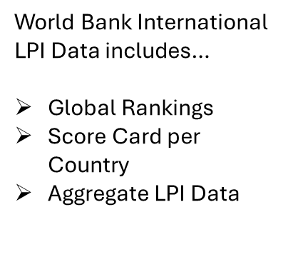

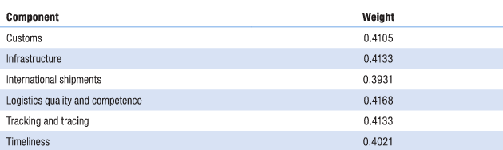
Power of LPI
International Scorecard Page | Logistics Performance Index (LPI)
LPI (Logistics Performance Index)- An interactive benchmarking tool created by the World Bank. Data is intended to be utilized by various stakeholders within the surveyed/ studied countries internally. In 2023, 139 countries had accessible survey data.
International LPI is rooted in the subjective perspectives of international logistics professionals, Supply Chain Tracking data is rather focused on Quantitative, objective analysis.
80% confidence intervals applied to all subcategories, landlocked countries may be disproportionately negatively affected due to decreased efficiency and naturally longer lead time (more complex international transit systems)

Slide 5
Data Analysis

Slide 6

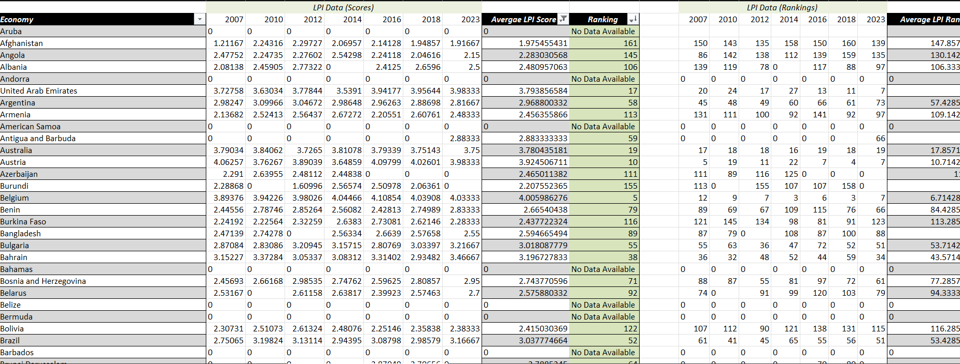
Methods and Results
Imported Total Population Data from the World Development Indicators from 1960-2023
Cleaned and formatted time series LPI scoring data from 2007-2023 (7 available data points)
Aggregated scores of subcategories and main LPI Rating, averaged subcategory scores and ranked main LPI
Combination of XLOOKUP, VLOOKUP
Compiled a single executive sheet with each country/ economies Total Population CAGR, and Average scores to be used in Regression
Analyzed Singapore as the number 1 ranked country on the LPI, created an interpolation model in Python with several scatter plots

Slide 7
Model 2 Correlation Data: 1.457E Significance F & 0.647 R-squared - Indicates that several subcategory independent variables help explain increase in CAGR.
Regression Models

Slide 8
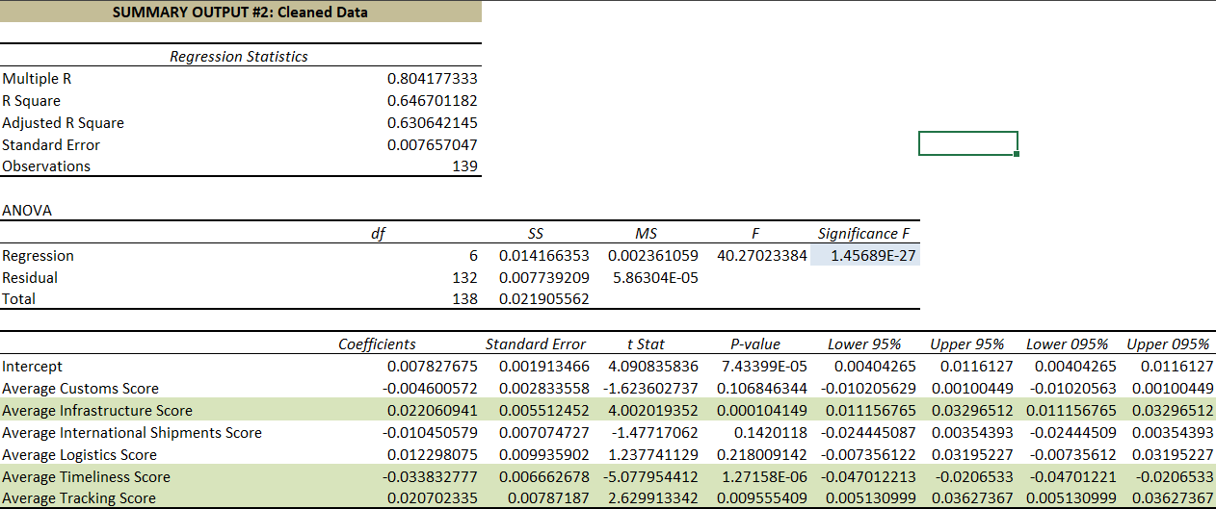
Regression Relationships
Average Infrastructure surveys scores increase by about 2% for every 1-point increase in Total Population CAGR. P-value = 0.0001
Average Timeliness survey scores decrease by 3.4% for every 1-point increase it Total Population CAGR. P-value = 1.27E
*lowest p-value signifies strongest correlation between a subcategory and CAGR
Average Tracking survey scores increase by 2% for every 1-point increase in Total Population CAGR. P-value = 0.009
*Cleaned & Transformed data, null values excluded, only subcategory scores used in the second regression output because independent variables were double counting

Slide 9
Visualizations

Slide 10
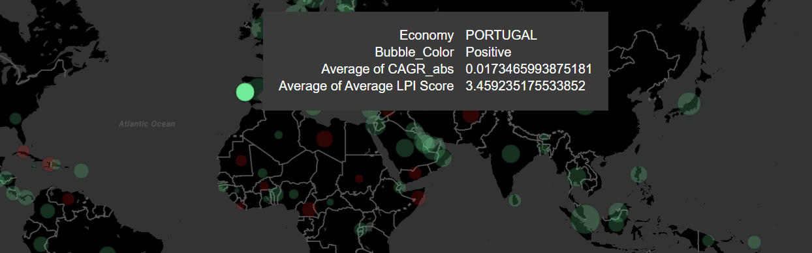
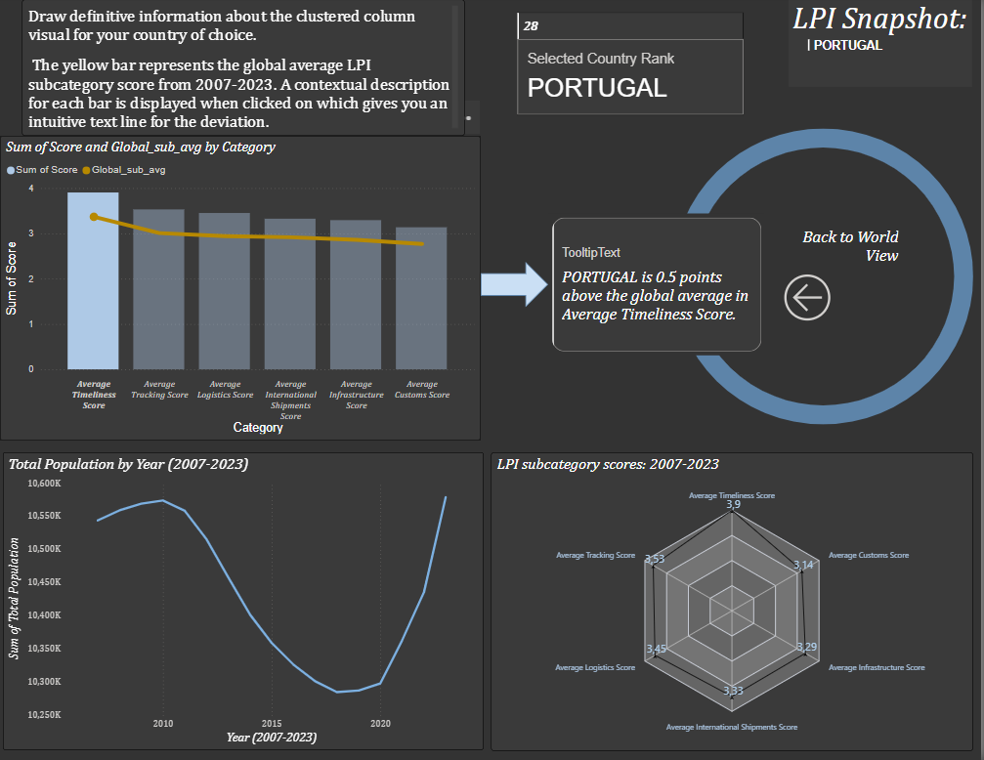
Drill Down
I created an interactive map, very much like the graphic on the World Bank’s official website, however, I utilized the aggregated CAGR and LPI scores from the time frame 2007-2023 instead of a single year's data
Portugal is the selected country in the image above; bubble size provides quick reference to the level of compounded annual growth in a country's population data. Larger bubbles indicate higher growth rates. The average LPI Score is sourced from my non-weighted calculations on my executive excel file
Right clicking on a country allows for users to drill-down on the country of choice and examine the scores for the LPI subcategories more in depth…

Slide 11
Country Profile Drilldown consists of…
Ranking and Country/ Economy name displayed at the top right for reference
6 subcategory scores displayed in a hexagon format with clear comparative value and objective statistics as the data labels above each category. Perfect for internal analysis of a country (comparing Timeliness scores to Infrastructure, analyzing strengths and weaknesses)
Bar and Line Chart Average
6 subcategory scores displayed as a bar chart; yellow solid line indicates the linear world average for each category. By clicking on each bar, the tooltip card on the right gives a definitive comparative statistic in words. Perfect for external comparative analysis (comparing Infrastructure score to world average- calculating differences, comparing countries to one another
Time Series Line Chart
Radar Chart
Measures Total Population trend from 2007-2023 to provide context to the drilldown page. Consider the relationships in the regression model, i.e. the correlations between CAGR and subcategories

Slide 12
Wrapping Up
Utilize this analysis for broad contextual analysis, compare countries on a global scale based on Logistics Performance Indicators and trends in Total Population - which may indicate fluctuation in several subcategories
Consider the opinions of accredited professionals surveyed by the World Bank, soon I plan to combine International LPI data with quantitative UN Comtrade data to create compelling, “industry-specific” supply chain analysis
This serves as a starting tool

